Slide 1
Association Analysis
Lecturer: Ji Shufan
2020.3.9

Slide 2
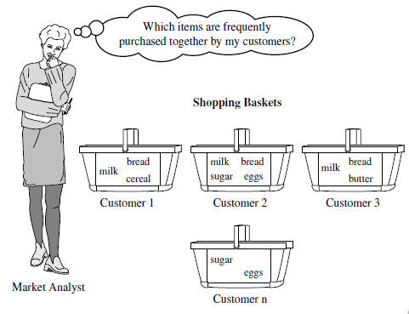
Motivation: Market Basket Analysis

Slide 3
Frequent Pattern & Association Rules
Draw associations among objects
Tr# | Items
T1 | Beer, Milk
T2 | Bread, Butter
T3 | Bread, Butter, Jelly
T4 | Bread, Butter, Milk
T5 | Beer, Bread
Frequent Patterns:
Bread, Butter (minSupport=3)
Association Rules:
Bread→Butter (Confidence=75%)
Butter→Bread (Confidence=100%)

Slide 4
Association Rule Measure
A→B (Support, Confidence)
Support= P(A ∩ B)
Confidence=P(B|A)=P(A ∩B)/P(A)
Lift= P(A ∩ B)/P(A)P(B)
Leverage= P(A ∩ B)-P(A)P(B)
Conviction=P(A)P(!B)/P(A ∩!B)

Slide 5
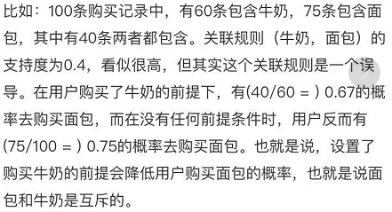
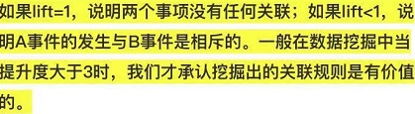
Association Rule Measure Example

Slide 6
Mining Frequent Pattern
TID | Items
10 | a, c, d
20 | b, c, e
30 | a, b, c, e
40 | b, e
minPatternLength=2
minSupport=2
What is the FP?

Slide 7
Frequent Pattern Mining Algorithm

Slide 8
The Apriori Algorithm
a,b,c,e
Bottom-up, breadth first search
Only read is perform on the databases
Store candidates in memory to simulate the lattice search
Iteratively follow the two steps:
  generate candidates
  count and get actual frequent items
b,c,e
b,c,e
a,b,c
a,b,e
a,c,e
b,c,e
a,b
a,c
a,e
b,c
b,e
c,e
a,c
b,c
b,e
c,e
a,b
a,c
a,e
b,c
b,e
c,e
a
b
c
e
a
b
c
e
a
b
c
e
start
{}

Slide 9
The Apriori Algorithm
A level-wise, candidate-generation-and-test approach (Agrawal & Srikant 1994)
Database D
1-candidates
Freq 1-itemsets
2-candidates
TID | Items
10 | a, c, d
20 | b, c, e
30 | a, b, c, e
40 | b, e
Itemset | Sup
a | 2
b | 3
c | 3
d | 1
e | 3
Itemset | Sup
a | 2
b | 3
c | 3
e | 3
Itemset
ab
ac
ae
bc
be
ce
Scan D
Min_sup=2
3-candidates
Freq 2-itemsets
Counting
Itemset
bce
Itemset | Sup
ac | 2
bc | 2
be | 3
ce | 2
Itemset | Sup
ab | 1
ac | 2
ae | 1
bc | 2
be | 3
ce | 2
Scan D
Freq 3-itemsets
Itemset | Sup
bce | 2

Slide 10
Other Alternatives?
a,b,c,e
Depth-first search
a,b,e
a,b,e
a,c,e
b,c,e
a,b
a,c
a,e
b,c
b,e
c,e
a
b
c
e
{}

Slide 11
Write-based Algorithm
TID | Items
10 | a, c, d, f
20 | b, c, e
30 | a, b, c, e
40 | b, e
e
a
b
c
TID | Items
10 | c, d,f
30 | b, c, e
TID | Items
20 | c, e
30 | c, e
40 | e
TID | Items
20
30
40
TID | Items
10 | d,f
20 | e
30 | e
ab
ac
ae
TID | Items
30 | c, e
TID | Items
10 | d
30 | e
TID | Items
30 | e
abc
abe

Slide 12
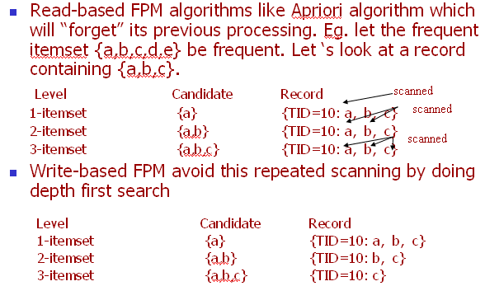
Why would write-based algorithms be faster ?

Slide 13
No Free Lunch
Using storage to reduce run time complexity
Pay higher cost in term of space complexity

Slide 14
Point-based Algorithm
Same as write-based, but use pointers to the data records in order to avoid physically replicating a part of the database.
Have to assume that the whole database can be fitted into memory.

Slide 15
Point-based Algorithm
a,b,c,e
a,b,e
a,b,e
a,c,e
b,c,e
TID
30
TID | Items
10 | a, c, d
20 | b, c, e
30 | a, b, c, e
40 | b, e
a,b
a,c
a,e
b,c
b,e
c,e
a,b
TID
10
30
a
a
b
c
e
in memory database
TID
10
20
30
40
{}

Slide 16
Summary: Lattice Transversal
a,b,c,e
TID | Items
10 | a, c, d
20 | b, c, e
30 | a, b, c, e
40 | b, e
a,b,c
a,b,e
a,c,e
b,c,e
Breadth first vs. Depth first
Bottom up vs top down
Read-based, Write-Based, Pointer-Based
a,b
a,c
a,e
b,c
b,e
c,e
a
b
c
e
{}

Slide 17
Three categories of FPM Algorithms
Read [AgSr94]
  Apriori-based. No write involved.
Write [Zaki00, HPY00, HaPe00]
  Perform write to improve performance.
Point [HPDW01]
  Memory based algorithm designed to point to various part of the data instead of re-writing the data in another part of the memory.

Slide 18
学习要求
了解关联规则、频繁模式的概念，以及度量指标。
了解数据库读写I/O是效率瓶颈，内存计算可忽略。
了解广度优先 vs. 深度优先遍历对频繁模式PF挖掘算法的性能影响。
学习巧妙应用指针，降低算法时间、空间复杂度的技巧。

Slide 19
阅读资料
Jiawei Han and Micheline Kamber
Data Mining: Concept and Technique
数据挖掘:概念与技术 第五章

